Slide 1

Fairfield Township Board of Trustees
FTZC21-2C Final PUD: MI Homes
Timber Trials Section One- Plan Review

Slide 2
FTZC21-2C Final PUD
Applicant: MI Homes of Cincinnati
Location: Liberty-Fairfield Road – North of State Route 4
A0300-019-000-013, A0300-019-000- 028, A0300-020-000-021, A0300-020-000-022,
A0300-020-000-023, A0300-020-000-0024, A0300-020-000-039 & A0300-020-000-033
Request: Final PUD Approval: Timber Trials –Section One

Slide 3
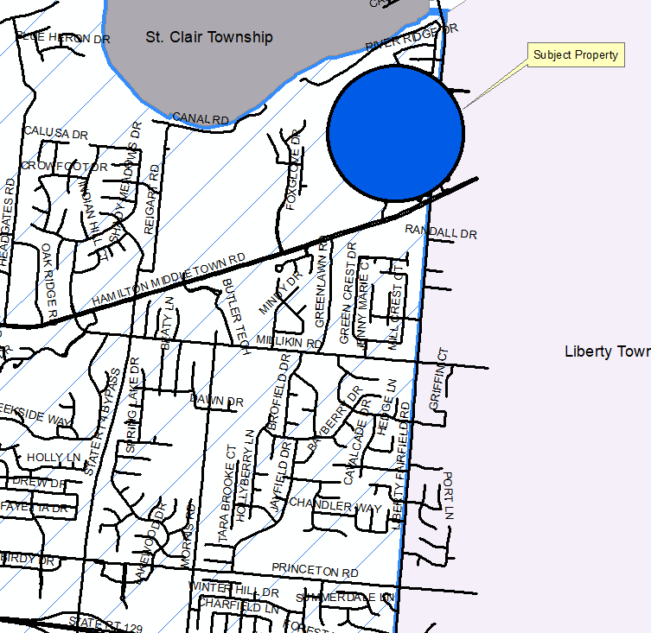
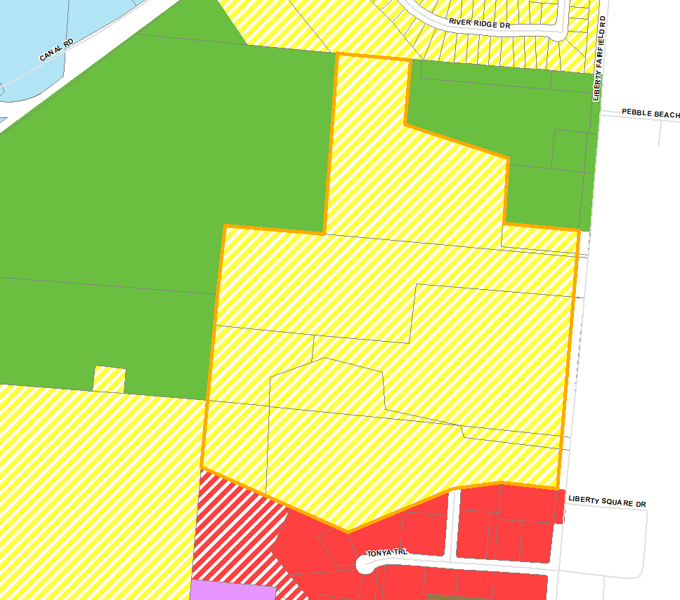
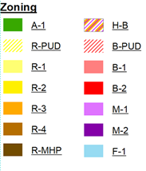
Situation of property

Slide 4
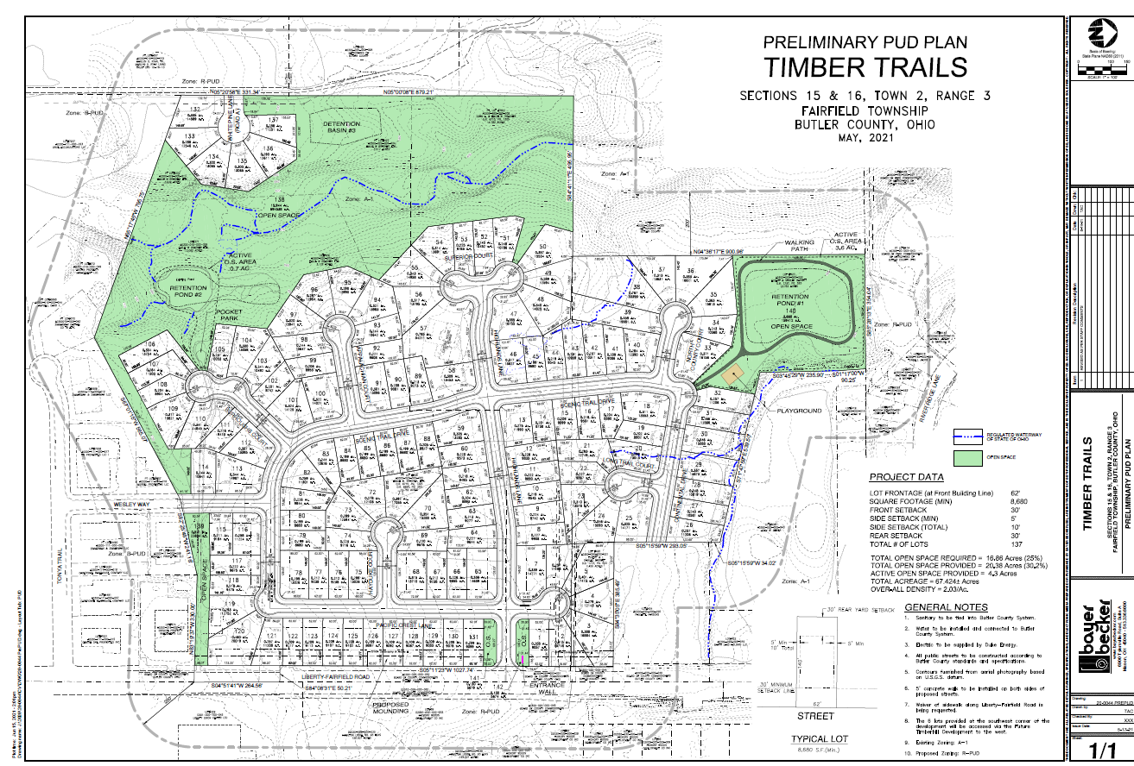

Slide 5
Description of Request
The applicant is requesting formal approval of the Final PUD Plan for Timber Trails—Section One

Slide 6
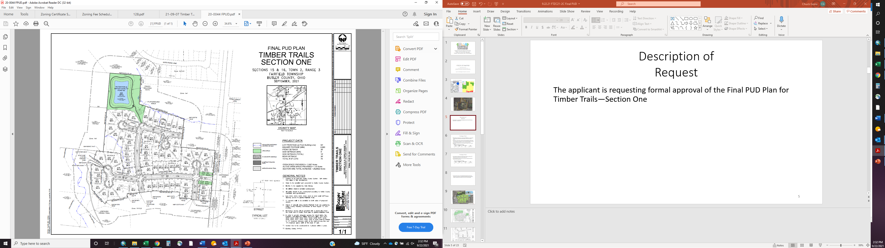

Slide 7
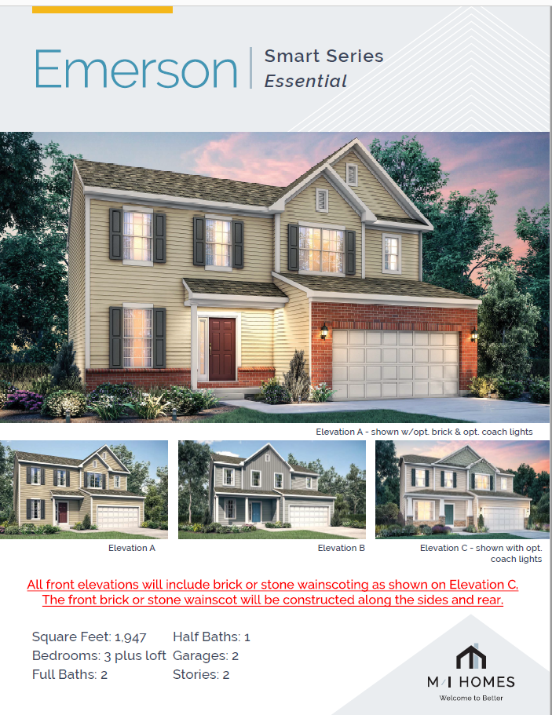
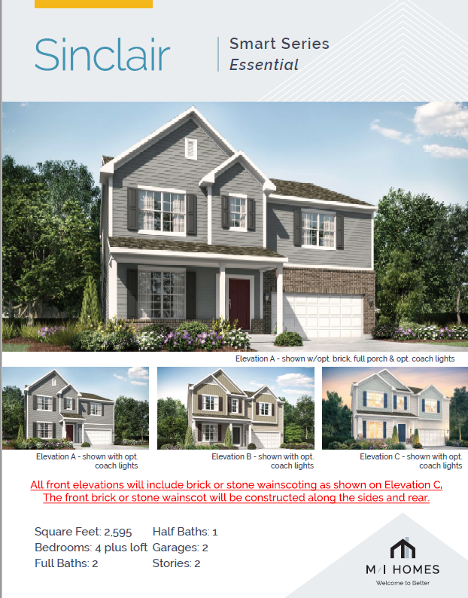
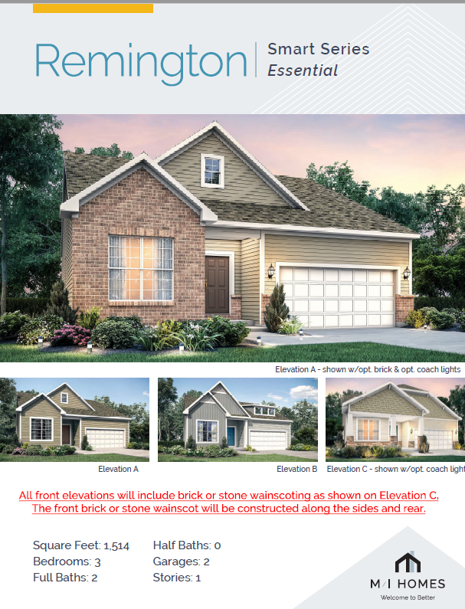

Slide 9
Recommendations and approvals
Butler County Planning Commission
The Butler County Planning Commission held a public hearing on June 8, 2021, and recommended approval of the Timber Trials proposal and provided 18 comments.
Fairfield Township Zoning Commission
The Fairfield Township Zoning Commission held a public hearing on June 16, 2021, and made the recommendation, to the Fairfield Township Board of Trustees, to approve, with conditions, the request for a Zone Change from A-1 (Agricultural District) to R-PUD (Residential Planned Unit Development).
Fairfield Township Board of Trustees
The Fairfield Township Board of Trustees held a public hearing on July 28, 2021. The Board of Trustees passed a resolution to approve, as recommended by the Fairfield Township Zoning Commission, the requested zone change by MI Homes.

Slide 10
Section 615.7 (a) of the Fairfield Township Zoning Resolution states:
Upon receipt of the detailed Final PUD Plan(s) for each section of the Planned Unit Development landholding, the Fairfield Township Board of Trustees shall study and review the detailed Final PUD Plan(s) and shall approve, modify or disapprove the plan(s)…

Slide 11
Staff Recommendation:
It is the opinion of the staff, that all conditions that were placed on the PUD during the Zone Change and the Preliminary PUD process have been addressed in the plans provided or are planned to be addressed in future sections of the PUD development. Staff further believes that the Final PUD Plan is consistent with sections 615.7 of the Township Zoning Resolution and will promote public health, safety, and the general welfare of the residents of Fairfield Township. Based on the findings of fact & submitted proposal to the Fairfield Township Board of Trustees staff make the makes the recommendation to Approve the Final PUD Plan for Section One of Timber Trials.

Slide 12
Fairfield Township Board of Trustees
FTZC21-2C Final PUD: MI Homes
Timber Trials Section One- Plan Review

